Slide 1
Braille CapTel
CapTel Solutions for People
with Combined Hearing and Vision Loss

Slide 2
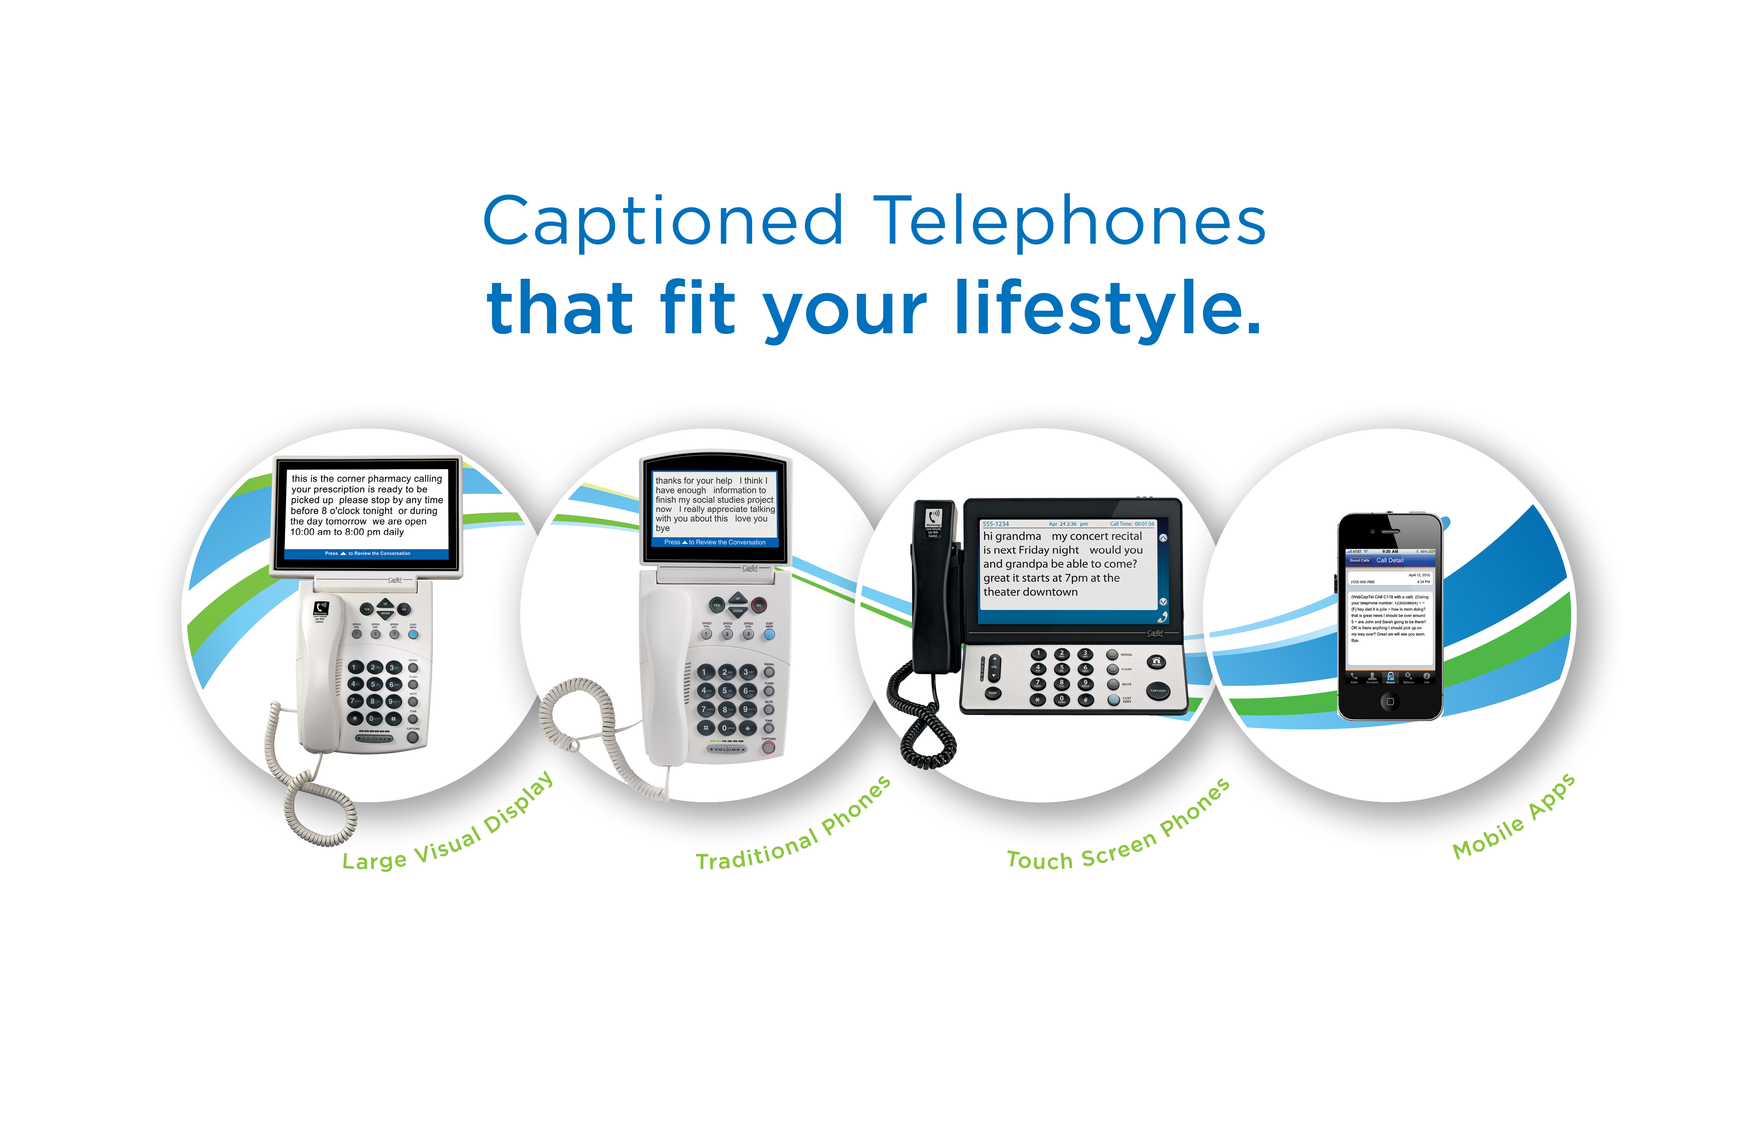

Slide 3
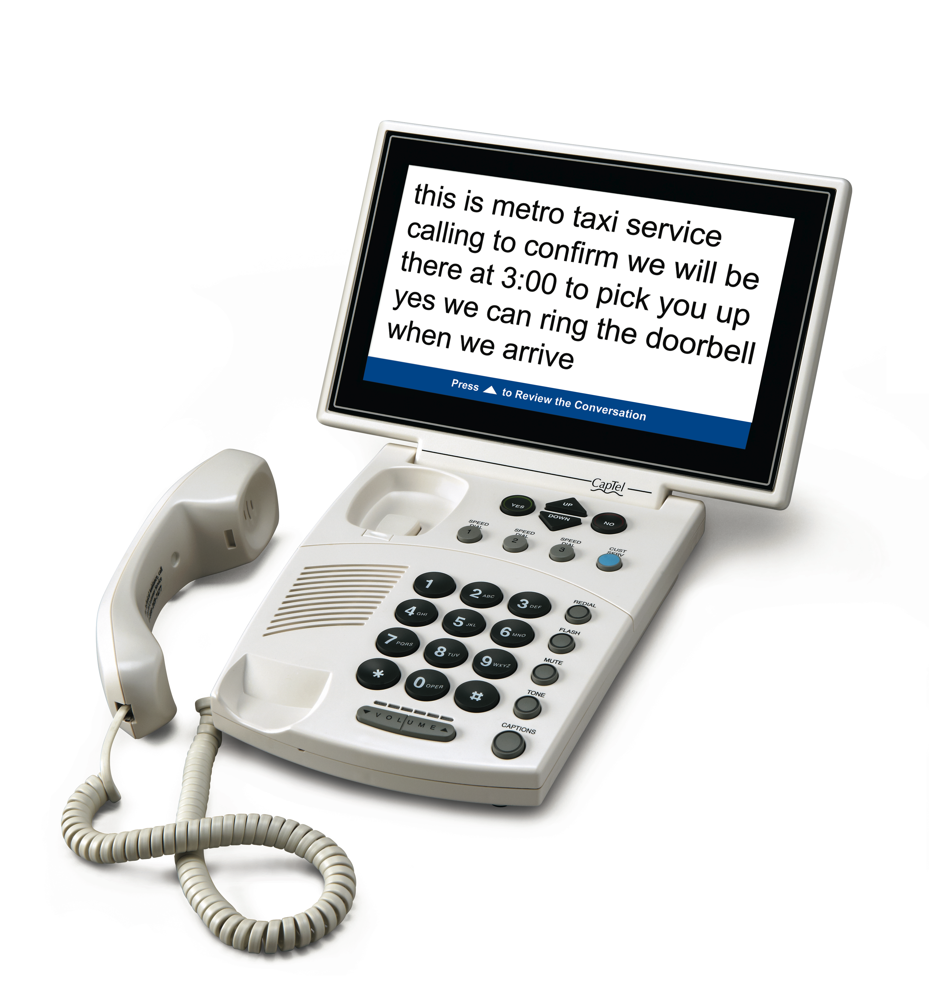
Large Display Captions
CapTel 880i
11” display
Large buttons
Easy, familiar design

Slide 4
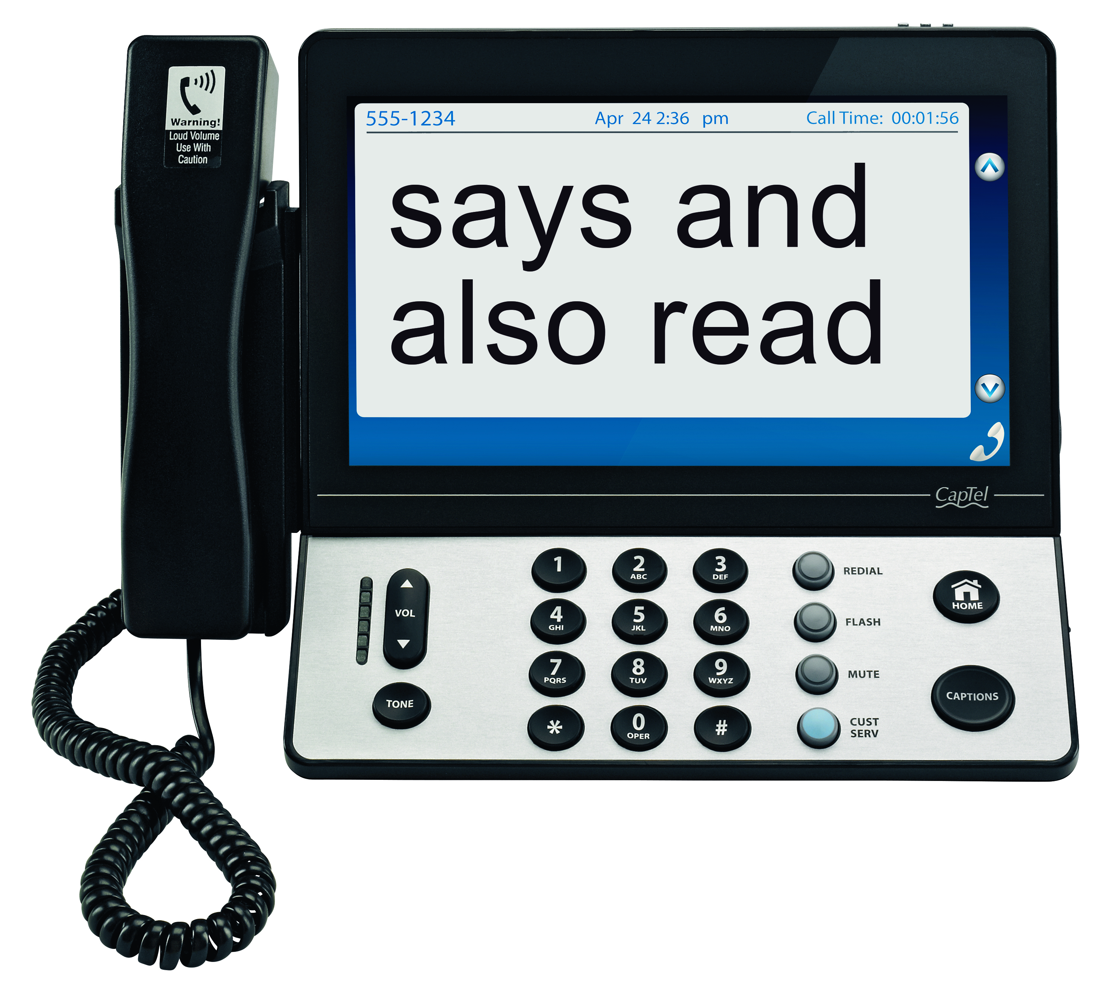
Large Display Captions
CapTel 2400i
11” display
Extra large font sizes
Color touch screen for easy navigation options
Dial-by-picture capability

Slide 5
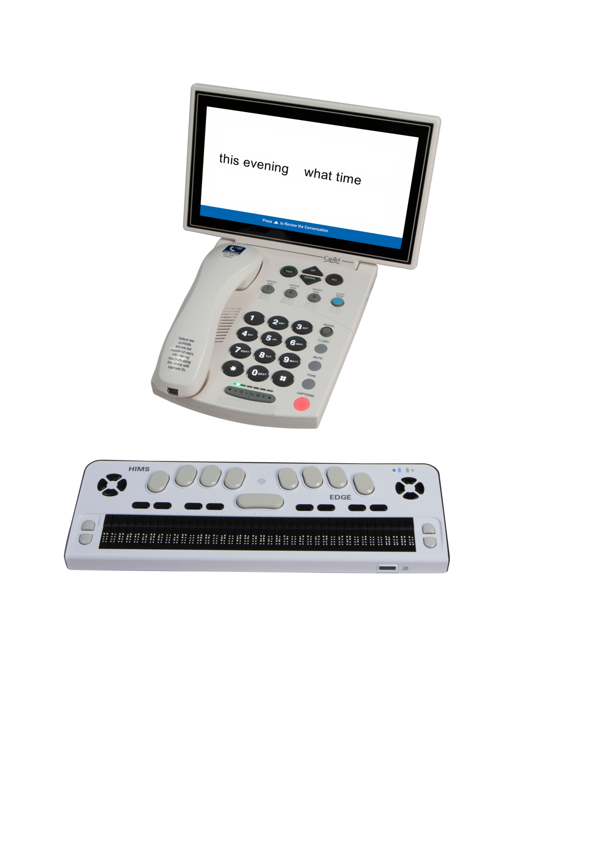
Braille CapTel®
CapTel 880iB
Braille Displays
Braille captions on your dynamic braille display
Requires a dedicated phone line and high speed Internet service
CapTel 880iB does not support WiFi
Braille displays connect via Bluetooth or USB
Power Line Network Adapters (PLNAs) not recommended

Slide 6
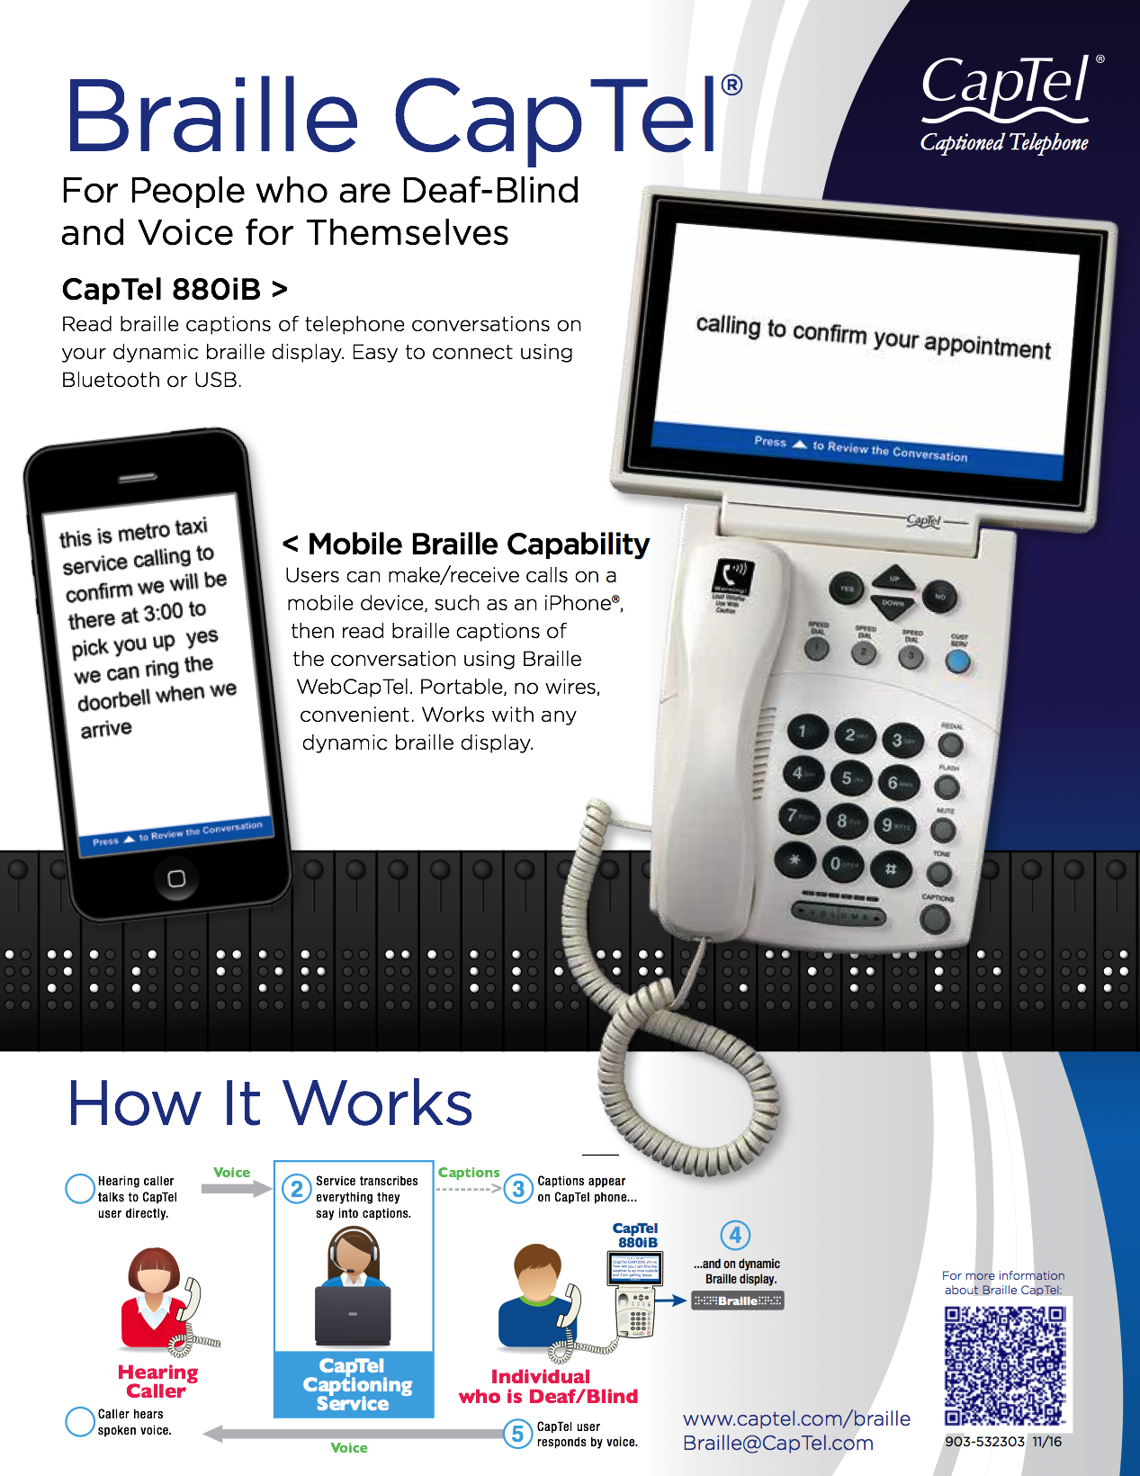

Slide 7
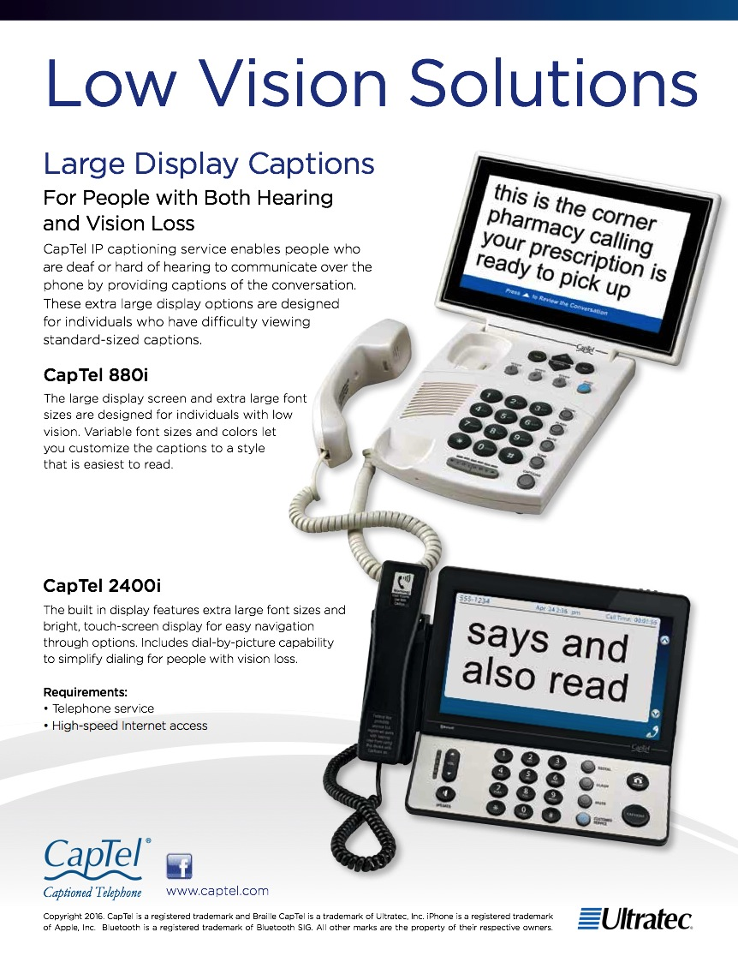

Slide 8
DeafBlind Agencies
iCanConnect
(National DeafBlind Equipment Distribution Program: NDBEDP)
Helen Keller National Center
Perkins School for the Blind
We are working with these agencies as helper/installers

Slide 9
Questions and Answers
          Do you have a list of agencies where I can get a CapTel 880iB?
          A. A list of iCC agencies is provided on the CapTel.com/braille website.

Slide 10
Questions and Answers
    Q. Where can I get a CapTel 880iB?
        Users can get it through NDBEDP (iCanConnect) or other agencies that support DeafBlind users.
        The 880i is not sold on our website, at stores or directly to customers. This is a specialized product.

Slide 11
Questions and Answers
          Does a Braille display come with the CapTel 880iB?
          No. The customer will use their own or will have to get one through their supplier.
          NOTE: A list of compatible Braille displays and a support video are listed on website: www.captel.com/braille

Slide 12
John Kinstler
Braille CapTel Product Manager
Ultratec, Inc.
450 Science Drive
Madison, WI 53711
(800) 482-2424 ext. 3008
(608) 232-5316
Email: John.kinstler@captel.com or Braille@CapTel.com
Web: www.captel.com/braille.php

